Slide 1
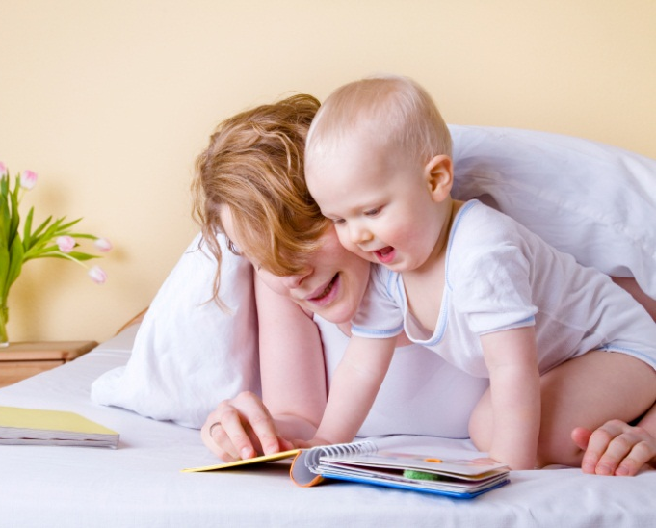
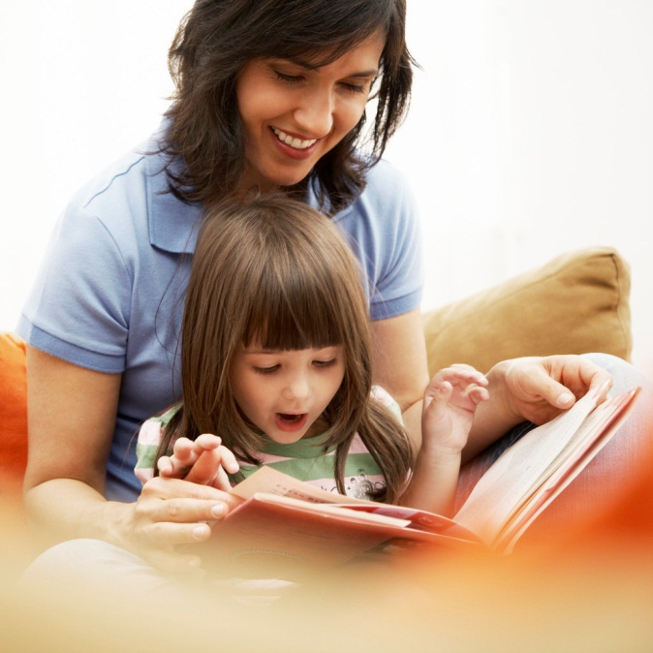
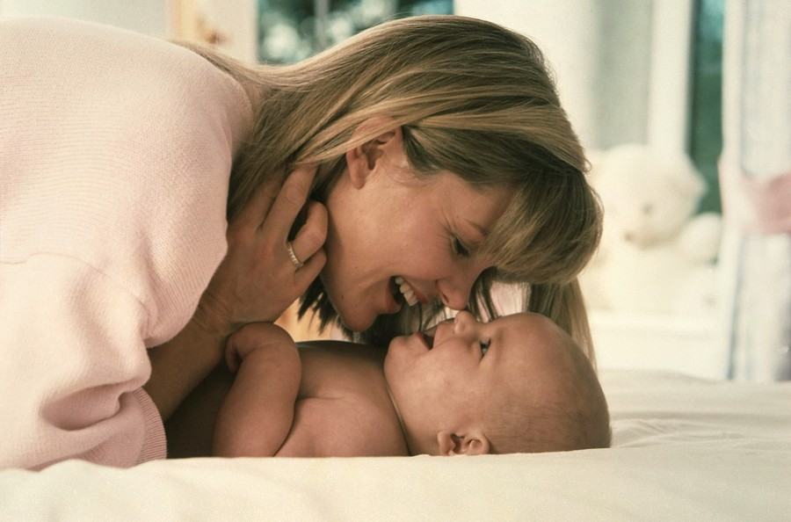
Sunday, May 13
Mother’s
Day
Special family breakfast
8:00 – 9:00am
plus
gift for each woman
A day especially for mum…

